Slide 1

SCSI 1013 Discrete Structure
CHAPTER 4 – PART 2
TREE
Semester 1 – 2017/2018

Slide 2
Introduction
Definition 1. A tree is a connected undirected graph with no simple circuits.
Theorem 1. An undirected graph is a tree if and only if there is a unique simple path between any two of its vertices.
Theorem 2 . A tree with m-vertices has m-1 edges

Slide 3
Which graphs are trees?
a)
b)
c)

Slide 4
Solution
Not a tree
vertices = 6
edges = 7
tree
vertices = 6
edges = 5
tree
vertices = 9
edges = 8

Slide 5
Rooted tree
Definition 2. A rooted tree is a tree in which one vertex has been designed as the root and every edge is directed away from the root.
a
b
d
c
e
f
g

Slide 6
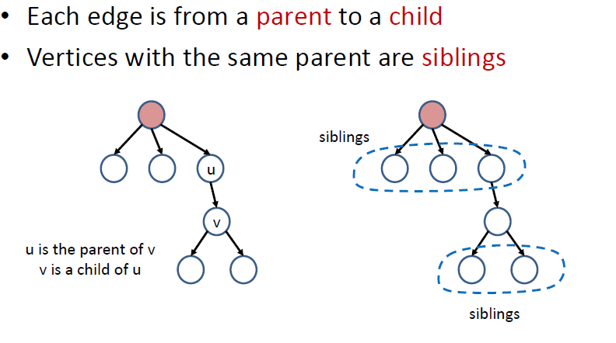
Rooted Tree - Terminologies

Slide 7
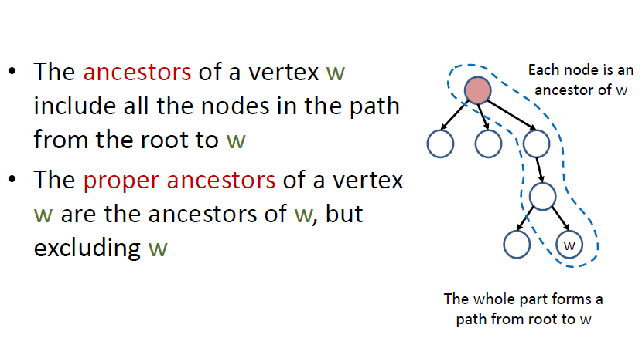
Rooted Tree - Terminologies

Slide 8
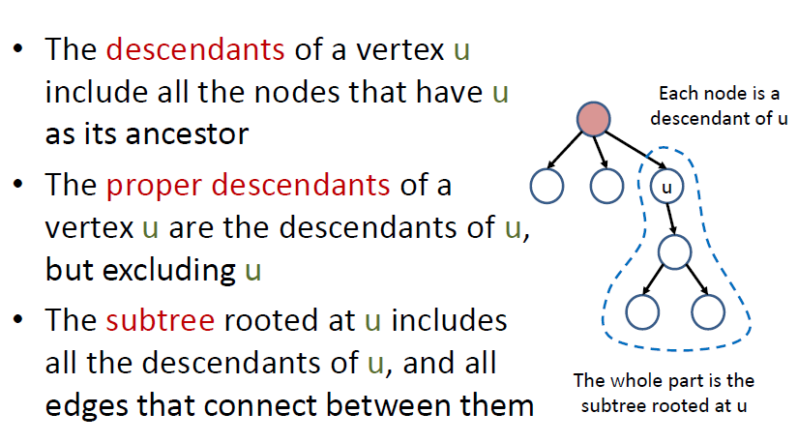
Rooted Tree - Terminologies

Slide 9
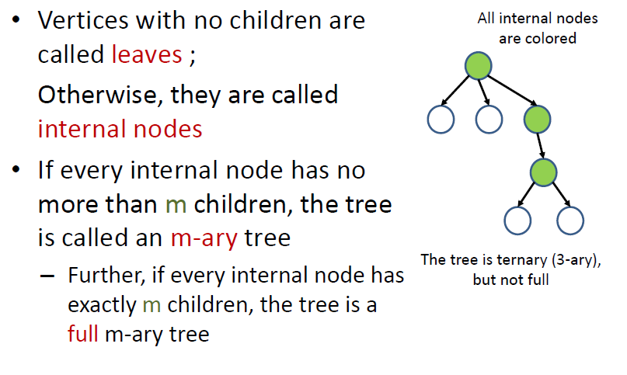
Rooted Tree - Terminologies

Slide 10
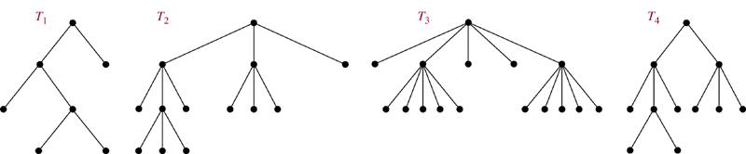
Examples
full binary tree
full 3-ary tree
full 5-ary tree
not full 3-ary tree

Slide 11
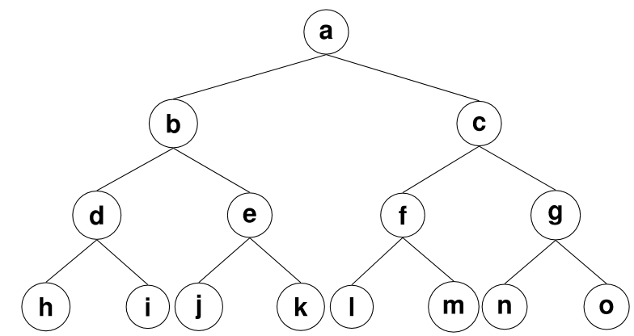
Exercise
Find:
Ancestors of g
Descendents of g
Parent of e
Children of e
Sibling of h

Slide 12
Solution
Find:
Ancestors of g: c, a
Descendents of g: n, o
Parent of e: b
Children of e: j, k
Sibling of h: i

Slide 13
Properties of Trees
Theorem 2 : A tree with n nodes has n-1 edges
Theorem 3 : A full m-ary tree with i internal vertices contains n = mi + 1 vertices.
Corollary is a result in which the (usually short) proof relies heavily on a given theorem
Corollary: A full m-ary tree with n vertices contains (n − 1) / m internal vertices, and hence n − (n − 1) / m = ( (m − 1) n + 1) / m leaves

Slide 14
Properties of Trees
Theorem 4 – A full m-ary tree with:
n vertices has internal vertices and
leaves

Slide 15
Properties of Trees
Theorem 4 – A full m-ary tree with:
i internal vertices has vertices and
leaves
Cont.

Slide 16
Properties of Trees
Theorem – A full m-ary tree with
l leaves has vertices and
internal vertices
Cont.

Slide 17
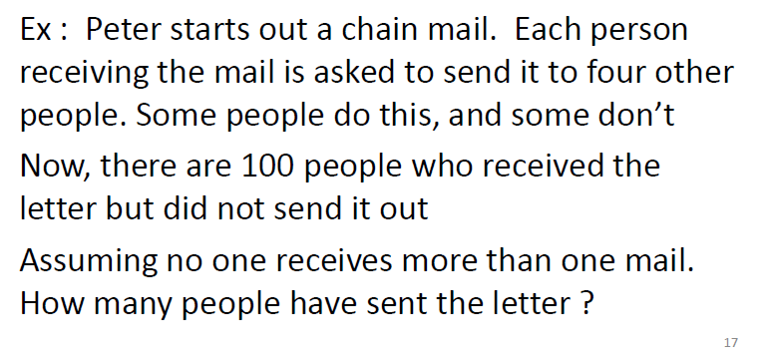
Example

Slide 18
Solution
The chain letter can be represented using 4-ary tree. The internal vertices correspond to people who sent out the letter, and the leaves correspond to people who did not send it out. Since 100 people did not send out the letter, the number of leaves in this rooted tree is, l=100. The number of people have seen the letter is n=(4x100-1)/(4-1)=133. The number of internal vertices is 133-100=33, people sent the letter.

Slide 19
Exercise
How many matches are played in a tennis tournament of 27 players?

Slide 20
Solution
A leaf for each player, l=27
An internal node for each matches: m=2
Number of matches:

Slide 21
Exercise
Suppose 1000 people enter a chess tournament. Use a rooted tree model of the tournament to determine how many games must be played to determine a champion, if a player is eliminated after one loss and games are played until only one entrant has not lost. (Assume there are no ties.)

Slide 22
Solution
We can model this tournament with a full binary tree. We know we have 1000 leaves for this tree because we have 1000 people. Each internal vertex will represent the winner of the game played by its children. The root will be the winner of the tournament.

Slide 23
Solution
By Theorem 4(3) with m = 2 and l = 1000. We know that:
We have 999 internal vertices, so we know 999 games must be played to determine the champion.

Slide 24
Properties of Trees
The level of a vertex v in a rooted tree is the length of the unique path from the root to this vertex.
The level of the root is defined to be zero.
The height of a rooted tree is the maximum of the levels of vertices.

Slide 25
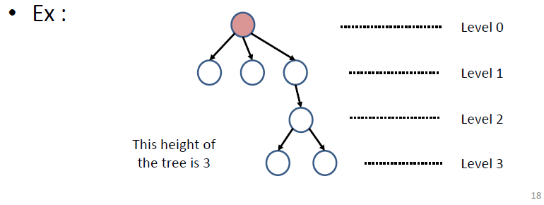
Example

Slide 26
Properties of Trees
Definition: A rooted m-ary tree of height h is balanced if all leaves are at levels h or h−1.
Theorem. There are at most m^{h} leaves in an m-ary tree of height h.

Slide 27
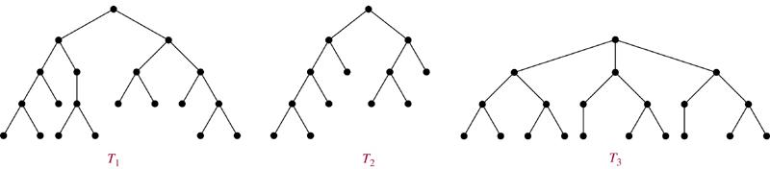
Example
Which of the rooted trees shown below are balanced?
Sol. T₁, T₃

Slide 28
Tree Traversal
Universal Address Systems
Label vertices:
root → 0, its k children → 1, 2, …, k (from left to right)
For each vertex v at level n with label A, its r children → A.1, A.2, …, A.r (from left to right).
We can totally order the vertices using the lexicographic ordering of their labels in the universal address system.
x₁.x₂…..x_{n} < y₁.y₂…..y_{m} if there is an i, 0 ≤ i ≤ n, with x₁ = y₁, x₂ = y₂, …, x_{i-1} = y_{i-1},
and x_{i}<y_{i}; or if n<m and x_{i} = y_{i} for i = 1, 2, …, n.

Slide 29
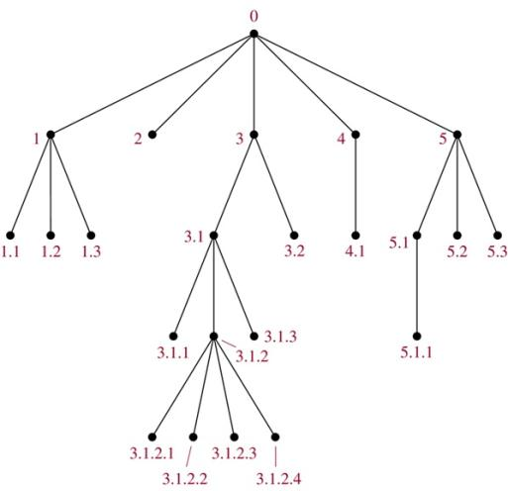
The lexicographic ordering is: 0 < 1<1.1 < 1.2 < 1.3 < 2 < 3 < 3.1 < 3.1.1 < 3.1.2 < 3.1.2.1 < 3.1.2.2 < 3.1.2.3 < 3.1.2.4 < 3.1.3 < 3.2 < 4 < 4.1 < 5 < 5.1 < 5.1.1 < 5.2 < 5.3

Slide 30
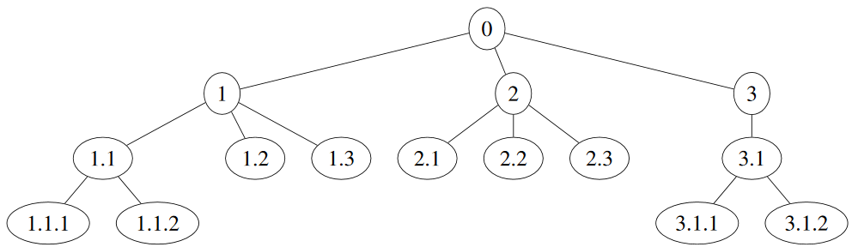
Exercise
Find the lexicographic ordering of the above tree.

Slide 31
Solution
The lexicographic ordering of the above tree:
0 < 1 < 1.1 < 1.1.1 < 1.1.2 < 1.2 < 1.3 < 2 < 2.1 < 2.2 < 2.3 < 3 < 3.1 < 3.1.1 < 3.1.2

Slide 32
Tree Traversal
Preorder: root, left-subtree, right subtree
Inorder – left subtree, root, right sub-tree
Post-order : left subtree, right sub-tree, root

Slide 33
Preorder Traversal
Procedure preorder(T: ordered rooted tree)
r := root of T
list r
for each child c of r from left to right
begin
T(c) := subtree with c as its root
preorder(T(c))
end

Slide 34
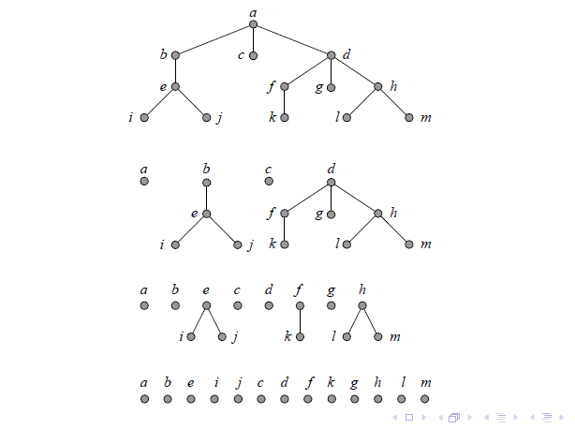
Preorder Traversal - Example

Slide 35
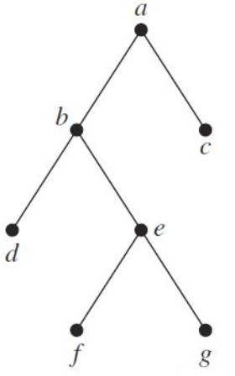
Exercise
Determine the order in which a preorder traversal visits the vertices of the given ordered rooted tree.

Slide 36
Solution
Determine the order in which a preorder traversal visits the vertices of the given ordered rooted tree.
The preorder traversal is: a, b, d, e, f, g, c

Slide 37
Inorder Traversal
Procedure inorder(T: ordered rooted tree)
r := root of T
If r is a leaf then list r
else
begin
l := first child of r from left to right
T(l) := subtree with l as its root
inorder(T(l))
list r
for each child c of r except for l from left to right
T(c) := subtree with c as its root
inorder(T(c))
end

Slide 38
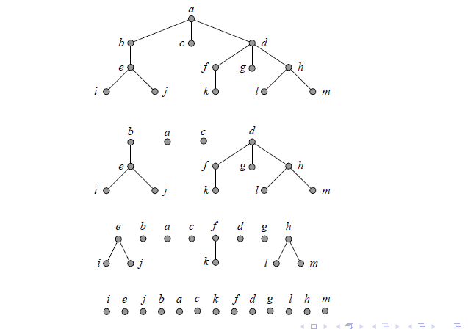
Inorder Traversal -Example

Slide 39
Exercise
Determine the order in which a inorder traversal visits the vertices of the given ordered rooted tree.

Slide 40
Solution
Determine the order in which a inorder traversal visits the vertices of the given ordered rooted tree.
The inorder traversal is: d, b, f, e, g, a, c

Slide 41
Postorder Traversal
Procedure postorder(T: ordered rooted tree)
r := root of T
for each child c of r from left to right
begin
T(c) := subtree with c as its root
postorder(T(c))
end
list r

Slide 42
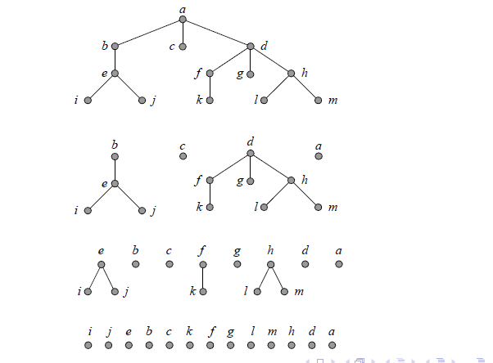
Postorder Traversal - Example

Slide 43

Exercise
Determine the order in which a postorder traversal visits the vertices of the given ordered rooted tree.

Slide 44
Solution
Determine the order in which a postorder traversal visits the vertices of the given ordered rooted tree.
The postorder traversal is: d, f, g, e, b, c, a

Slide 45
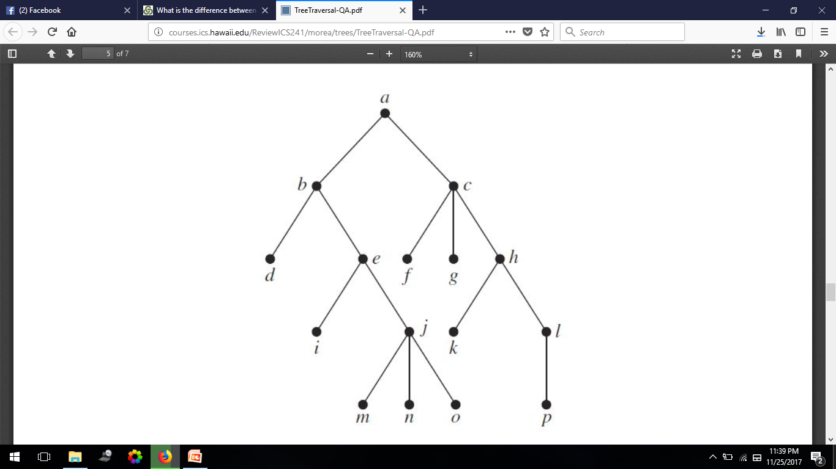
Exercise
Determine the order of preorder, inorder and postorder of the given rooted tree.

Slide 46
Solution
Determine the order of preorder, inorder and postorder of the given rooted tree.
Preorder: a, b, d, e, i, j, m, n, o, c, f, g, h, k, l, p
Inorder: d, b, i, e, m, j, n, o, a, f, c, g, k, h, p, l
Postorder: d, i, m, n, o, j, e, b, f, g, k, p, l, h, c, a

Slide 47
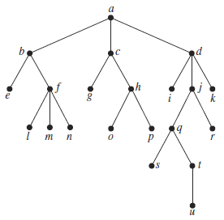
Exercise
Determine the order of preorder, inorder and postorder of the given rooted tree.

Slide 48
Solution
Determine the order of preorder, inorder and postorder of the given rooted tree.
Preorder: a, b, e, f, l, m, n, c, g, h, o, p, d, i, j, q, s, t, u, r, k
Inorder: e, b, l, f, m, n, a, g, c, o, h, p, i, d, s, q, u, t, j, r, k
Postorder: e, l, m, n, f, b, g, o, p, h, c, i, s, u, t, q, r, j, k, d, a

Slide 49
Spanning Trees
A spanning tree is a simple graph that is a subgraph of G and contains every vertex of G and is a tree.
A connected
undirected graph
Four spanning trees of the graph

Slide 50
Minimum Spanning Tree (MST)
A Minimum Spanning Tree is a spanning tree on a weighted graph that has minimum total weight.
Example
a
b
a
b
5
a
5
b
a
b
a
b
5
6
3
2
2
3
2
6
2
3
3
7
7
c
4
d
c
d
c
4
d
c
d
c
d
4
T₁= 10
T₂= 12
T₃= 12
T₄= 12

Slide 51
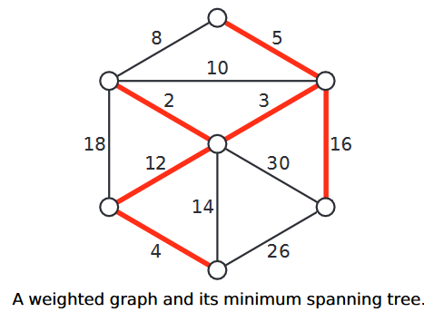
Minimum Spanning Tree (MST)

Slide 52
Muddy City Problem
Once upon a time there was a city that had no roads. Getting around the city was particularly difficult after rainstorms because the ground became very muddy. Cars got stuck in the mud and people got their boots dirty. The mayor of the city decided that some of the streets must be paved, but didn’t want to spend more money than necessary because the city also wanted to build a swimming pool.

Slide 53
Muddy City Problem
The mayor therefore specified two conditions:
1. Enough streets must be paved so that it is possible for everyone to travel from their house to anyone else's house only along paved roads, and
2. The paving should cost as little as possible.
Here is the layout of the city. The number of paving stones between each house represents the cost of paving that route. Find the best route that connects all the houses, but uses as few counters (paving stones) as possible.

Slide 54
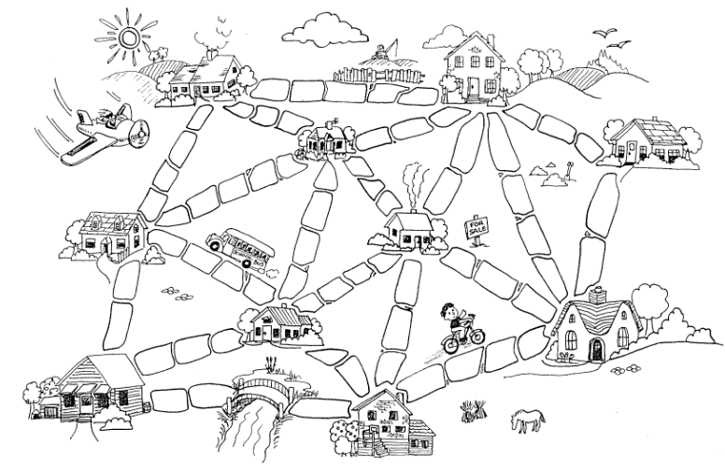

Slide 55
Muddy City Problem
The graph
5
3
3
3
4
2
5
4
3
4
2
4
4
3
2
3
3
2
4
4

Slide 56
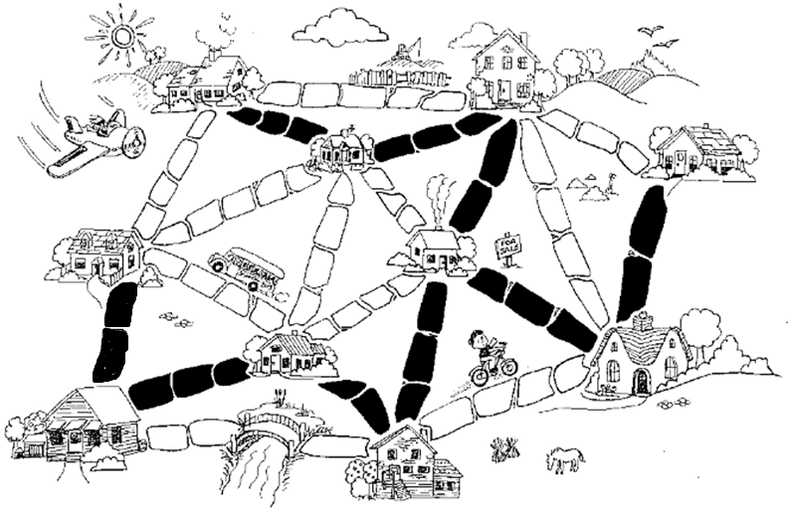
Muddy City Problem
The paving

Slide 57
Application of MST: Examples
In the design of electronic circuitry, it is often necessary to make a set of pins electrically equivalent by wiring them together.
Running cable TV to a set of houses. What’s the least amount of cable needed to still connect all the houses?

Slide 58
Finding MST
Kruskal’s algorithm: start with no nodes or edges in the spanning tree and repeatedly add the cheapest edge that does not create a cycle

Slide 59
Kruskal algorithm
Procedure Kruskal (G: weighted connected undirected graph with n vertices)
T:= empty graph
for i := 1 to n-1
begin
e:= any edge in G with smallest weight that does not
form a simple circuit when added to T
T:= T with e added
end (T is a minimum spanning tree of G)

Slide 60
A cable company want to connect five villages to their network which currently extends to the market town of Avonford. What is the minimum length of cable needed?
Example
Brinleigh
5
Cornwell
3
4
8
6
8
Avonford
Fingley
Donster
7
5
4
2
Edan

Slide 61
Example
We model the situation as a network, then the problem is to find the minimum connector for the network.
B
5
C
3
4
8
6
8
A
F
D
7
5
4
2
E

Slide 62
Kruskal’s Algorithm
List the edges in order of size:
ED 2
AB 3
AE 4
CD 4
BC 5
EF 5
CF 6
AF 7
BF 8
CF 8
B
5
C
3
4
8
6
8
A
D
7
F
5
4
2
E

Slide 63
Kruskal’s Algorithm
Select the shortest
edge in the network
ED 2
B
5
C
3
4
8
6
8
A
D
7
F
5
4
2
E

Slide 64
Kruskal’s Algorithm
Select the next shortest edge which does not create a cycle
ED 2
AB 3
B
5
C
3
4
8
6
8
A
D
7
F
5
4
2
E

Slide 65
Kruskal’s Algorithm
Select the next shortest edge which does not create a cycle
ED 2
AB 3
CD 4 (or AE 4)
B
5
C
3
4
8
6
8
A
D
7
F
5
4
2
E

Slide 66
Kruskal’s Algorithm
Select the next shortest edge which does not create a cycle
ED 2
AB 3
CD 4
AE 4
B
5
C
3
4
8
6
8
A
D
7
F
5
4
2
E

Slide 67
Kruskal’s Algorithm
Select the next shortest edge which does not create a cycle
ED 2
AB 3
CD 4
AE 4
BC 5 – forms a cycle
EF 5
B
5
C
3
4
8
6
8
A
D
7
F
5
4
2
E

Slide 68
Kruskal’s Algorithm
All vertices have been connected.
The solution is
ED 2
AB 3
CD 4
AE 4
EF 5
Total weight of tree: 18
B
5
C
3
4
8
6
8
A
D
7
F
5
4
2
E

Slide 69
Kruskal’s Algorithm
Important notes:
The graph given should be a tree
Remove all loops (if any)
Remove all parallel edges
keep the one which has the least weight associated and remove all others

Slide 70
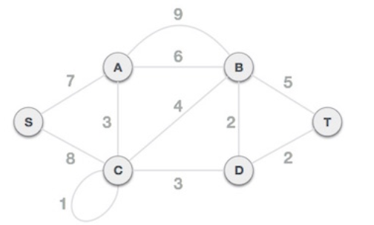
Example

Slide 71
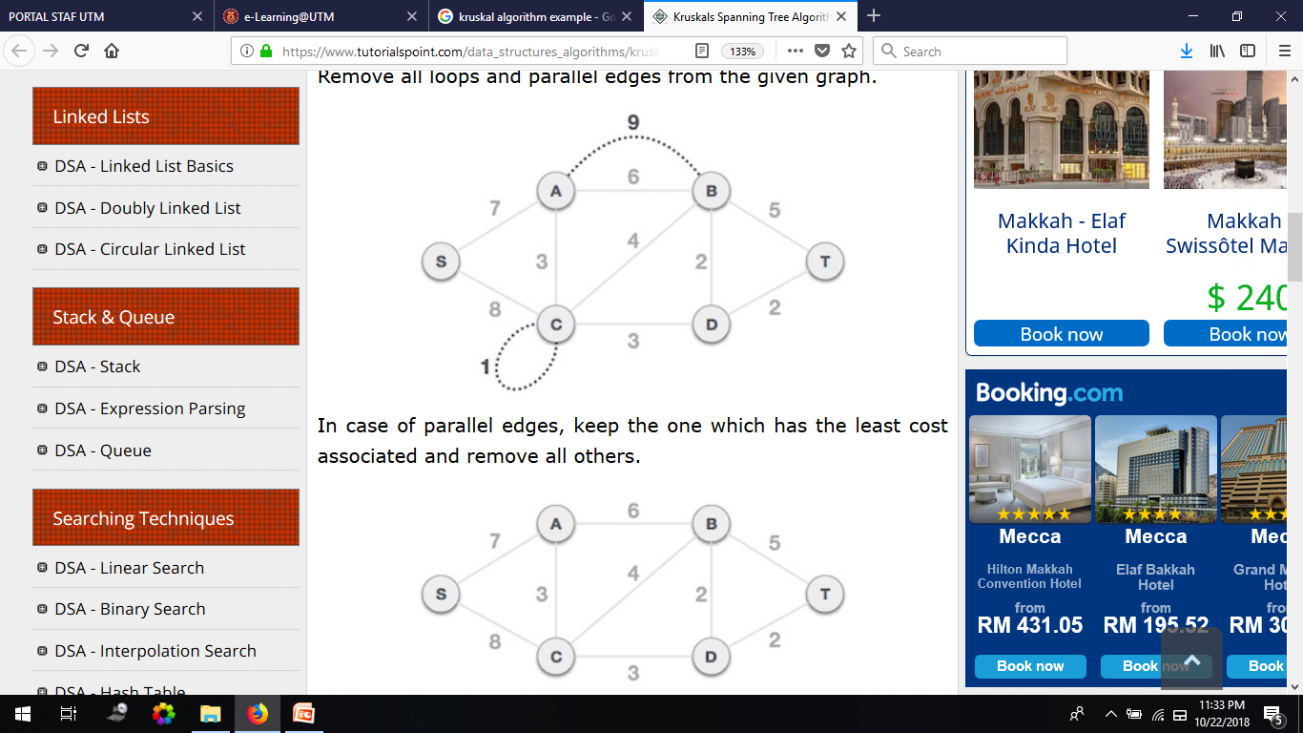
Example
Remove all loops and parallel edges

Slide 72
Example
Arrange all edges in their increasing order of weight
BD | DT | AC | CD | CB | BT | AB | SA | SC
2 | 2 | 3 | 3 | 4 | 5 | 6 | 7 | 8

Slide 73
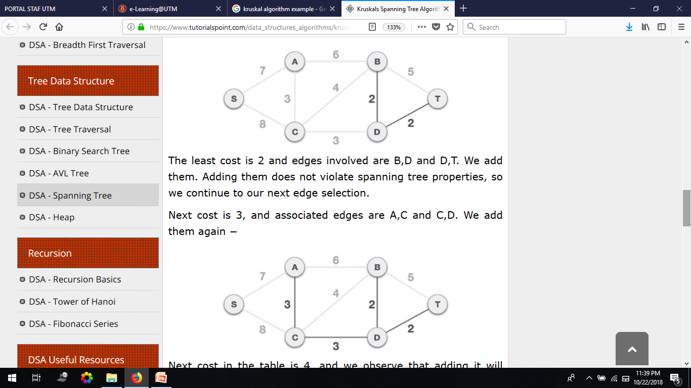
Example
Add the edge which has the least weightage
The least weight is 2 and edges involved are BD and DT
Next weight is 3, and associated edges are AC and CD

Slide 74
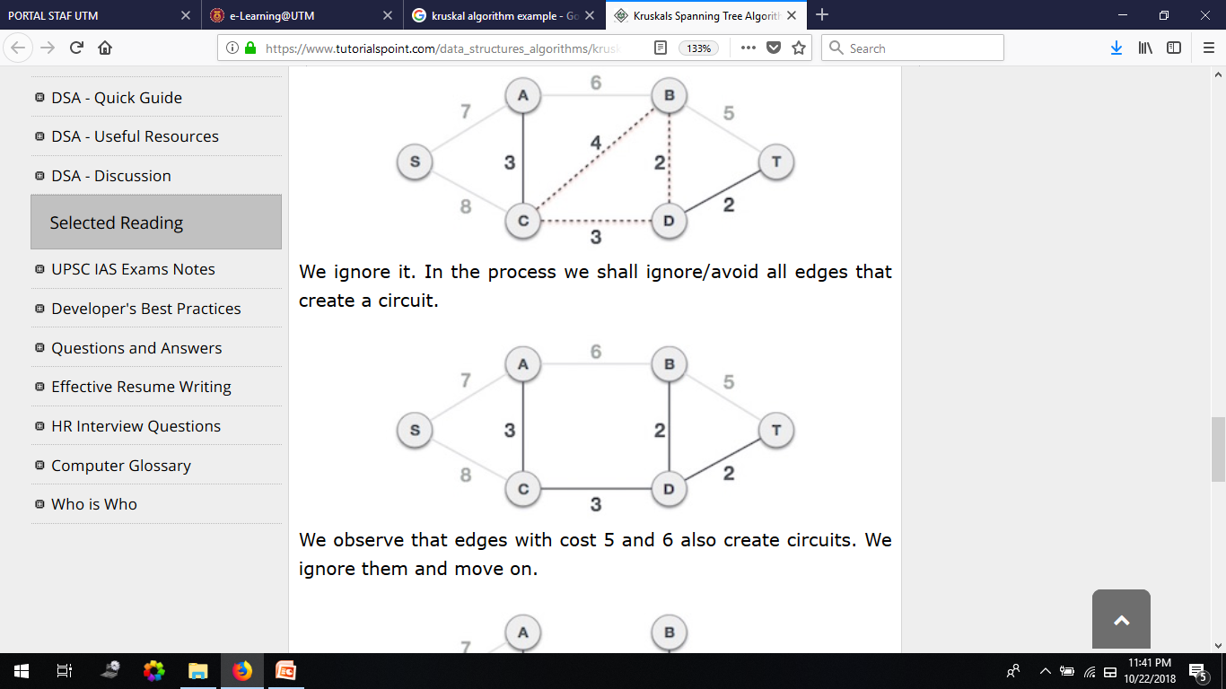
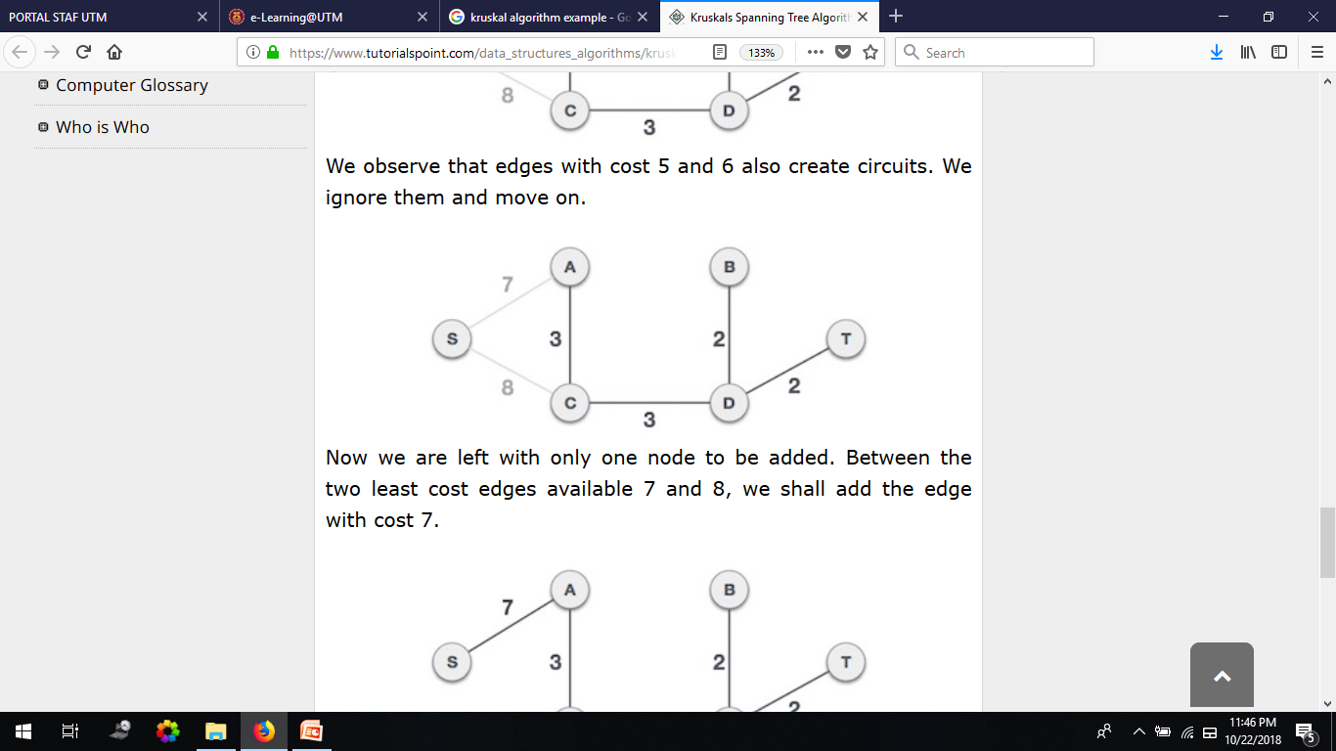
Example
Next weight is 4, and we observe that adding it will create a circuit in the graph. Thus, we ignore it.
We observe that edges with weight 5 and 6 also create circuits. We ignore them and move on.
Now we are left with only one node to be added. Between the two least weighted edges available 7 and 8, we shall add the edge with weight 7.

Slide 75
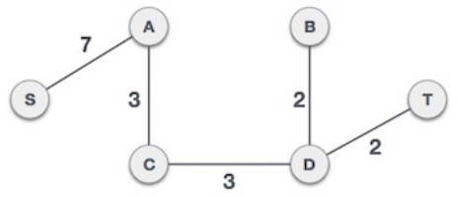
Example
Now we have minimum spanning tree with total weight is 17.

Slide 76
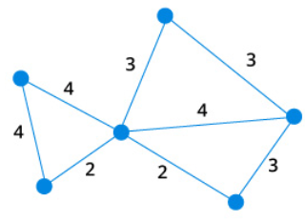
Exercise
Find the minimum spanning tree using Kraskal’s Algorithm and give the total weight for the minimum spanning tree.

Slide 77
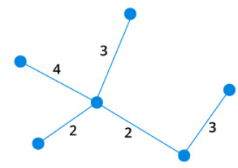
Solution
Total weight is 14.

Slide 78
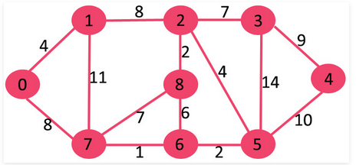
Exercise
Find the minimum spanning tree using Kraskal’s Algorithm and give the total weight for the minimum spanning tree.

Slide 79
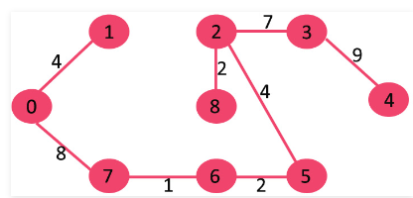
Solution
Total weight is 37.

